Slide 1
Service Desk Knowledge Base
Training
November 15, 2007

Slide 2
Objectives
The Service Desk Knowledge Base (SDKB) training course prepares team leaders and solution champions for supporting their teams in successful use of SDKB at TransAlta, and:
  Master the use of SDKB Solution
  Introduce the KM (Knowledge Management) process
  Become familiar with the KM roles and responsibilities
  Know where to go for help with SDKB and KM
  Align KM Process to SKDB Solution

Slide 3
Knowledge Management and using SDKB
Training Course Outline
  KM
    What is KM
    Roles and responsibilities
    Goals
    KM Process
  SDKB
    Getting started
    Searching
    Viewing articles
    Update articles
    Providing feedback
    Linking articles
  Authoring
    Workflow
    Writing a new articles
    Updating existing articles
    Technical review
    Content review
    Best practices
    Writing standards
  Getting Help
  KM/SDKB Alignment

Slide 4
Knowledge Management

Slide 5
What is Knowledge Management
Knowledge Management (KM) is:
  the systematic capture and reuse of knowledge gained through customer interactions during support events
KM is a set of behaviors and processes followed by people who are members of the support workforce who use a common solution set

Slide 6
What is Knowledge Management
Knowledge Management is a set of practices & processes focused on knowledge as a key asset of a support organization
KM Strategy:
Share and reuse knowledge as a by-product of solving problems
Enable capacity gains by the workforce to support company growth
Evolve content on demand and usage
Develop a Knowledge Base of our collective experience to date
Reward learning , collaboration, sharing, and improving our intellectual assets
KM is not something we do in addition to solving problems …
KM becomes the way we solve problems

Slide 7


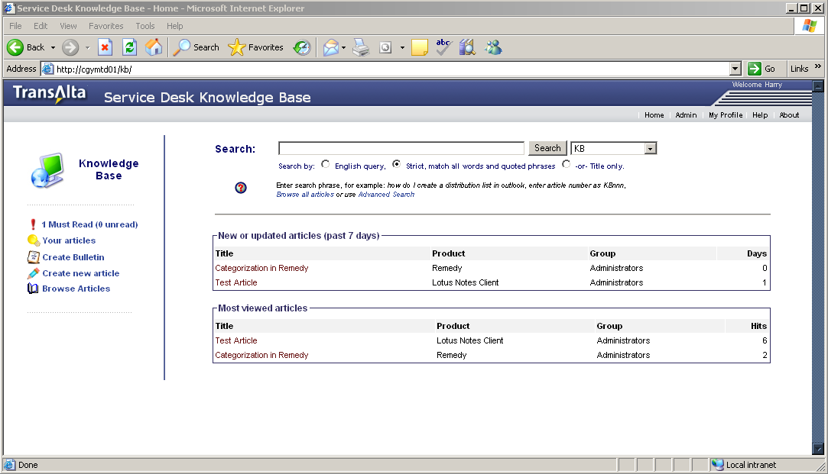

KM Made Easy
?
Customer
Service Desk
(1st level)
Customer Calls TransAlta
Support
Problem solved, solution documented
Second Level
Support

Slide 8
KM Made Easy
?
Customer
Service Desk
(1st level)
Customer Calls TransAlta
Support
Problem solved, solution documented

Slide 9
KM Roles
All KM roles work together to implement and maintain a healthy knowledge environment
KM Role assignments are tracked in the KM system
KM Roles
KM
Administrator
Content
Owner /
Support Group
Author/
Submitter
Consumer

Slide 10
KM Roles
Consumer
  Read-only user, searches and link documents, provides feedback on content
Author/Submitter
  Reuses, updates, creates and submits solutions for tech reviews
Content Owner (member of support team and assigned by manager)
  Checks inbox for solutions awaiting tech review and performs tech/content reviews
  Submits reviewed documents for publishing (Edits if necessary)
  Returns documents that require revisions to compose state
  Advocates and Communicates the KM methodology to their local team
  Ensure quality of content and tag solutions for publication to appropriate portals
  Processes feedback to improve articles
KM Administrator (member of support team and assigned by manager)
  First line of support for solution issues and questions
  Create and maintain Capture profiles in User Database
  Reviews and analyzes metrics to identify trends and implement action plans
  Methodology Review and Publishing knowledge articles in Knowledge Base (KB)
Notes:
You need to belong to a group to create an article.
If you have comments – use notes

Slide 11
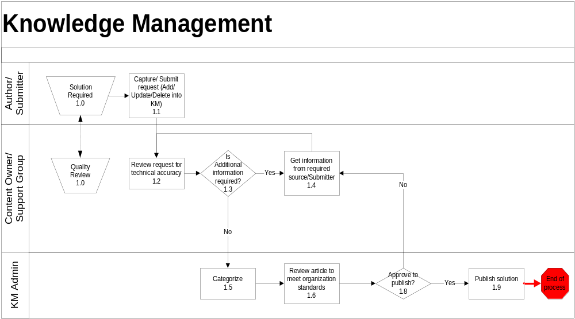
Process Overview

Slide 12

KM / Incident Process Flow
3
1
2
Link to
Incident
Find
Doc
No
Start
Log Case
in Remedy
System
Search KBs
Yes
Needs
Mod?
No
Yes
Author/
Add Notes?
No
6
Step
Event Description (System Utilized)
Yes
1
Log customer case in Remedy System
4,5
Create or
Modify Doc
2
Search or browse for support information in KB
3
Article found in KB, link article to customer case in Remedy System
3
Link to
Case
4
No solution found, create a new article and save it in the knowledge base
6
Technical
Review
5
Article found but needs updating, modify the existing article and save it in the knowledge base
No
Final
Review
Approve?
Submit to
KB as final
End
6
Submit article for technical review
7
Yes
7
Final review
Use the Add Notes button to request an update to an article

Slide 13
KM Leading Indicators
Do the cases we solve have accurate content in the KB?
We do not want to waste our time or the customer’s time by solving the same problem over and over…
  We want to measure our content effectiveness, therefore we must link KB content to Incident cases
  We can speed incident resolution/service response by accurately documenting solutions for common customer calls
If we have content in the KB available to customers, IT can enable self-service, reduce costs and improve customer satisfaction!

Slide 14
Service Desk
Knowledge Base

Slide 15

Service Desk Knowledge Base
KB is a custom solution developed with one word
in mind:
Google is an example of a search engine that requires minimal training to use and works as expected

Slide 16
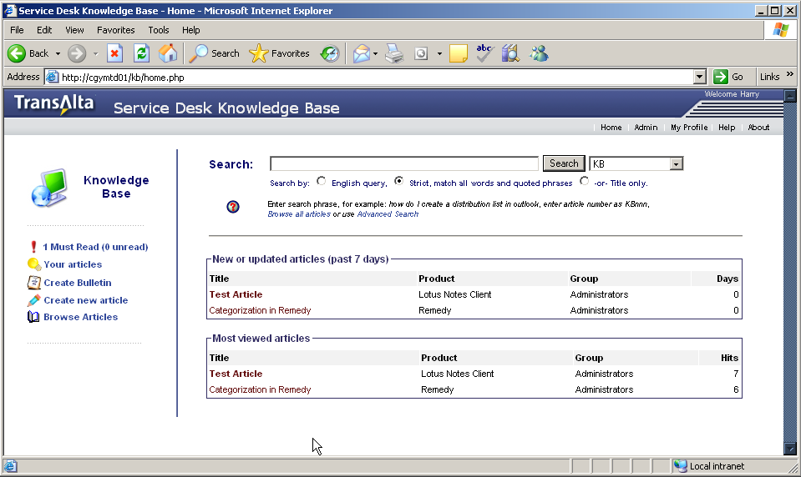
KB Home Page
From the home page, it is possible to:
perform a search, see the most reviewed articles,
modify your profile, or access the content editor

Slide 17
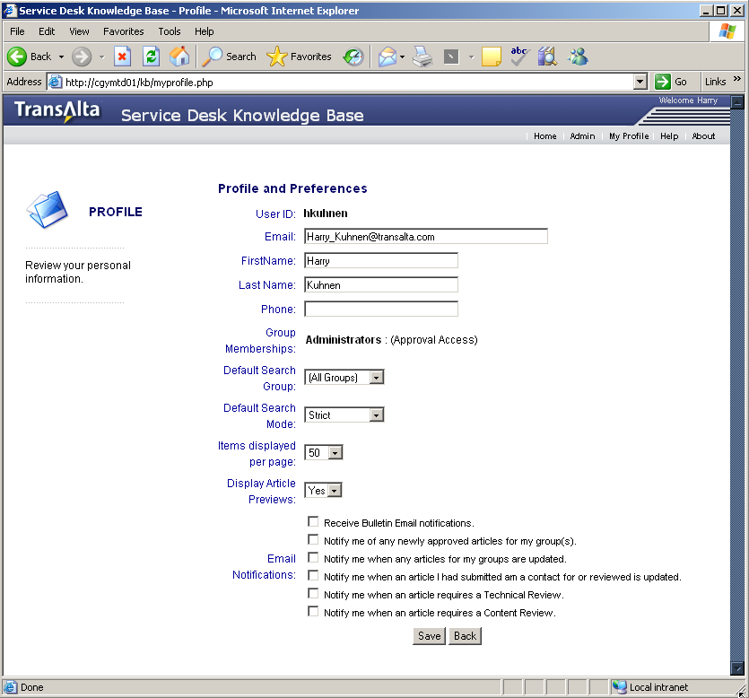
How to Set Preferences
Click on My Profile on the home page menu to modify preferences for:
  Email notifications
  Display options

Slide 18
Searching for Information using SDKB
SDKB can be used to search or navigate the central repository which holds process and support content
Search includes:
Basic search — Enter search criteria and specify preference for English query or Strict (match all words and quoted phrases) or Title only search
Advanced search — Search by group, article type, or product
Browse — Browse articles by product

Slide 19
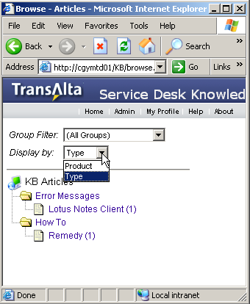
Browse
To view all articles by product or type: Select Browse Articles and select product or type under the Display by: field drop down list.
The number to the right, denotes how many articles are associated with the list

Slide 20
Basic Search
Enter search string, select matching preference and Select button
Wildcard (*) is supported however you cannot use the wildcard at the start of the word, for example *Station.

Slide 21
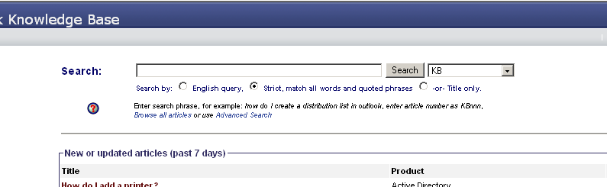
Remedy Search
In addition to searching the KB you can search other Remedy incidents to see how similar issues were resolved by others
If solution is reusable consider creating a KM article

Slide 22
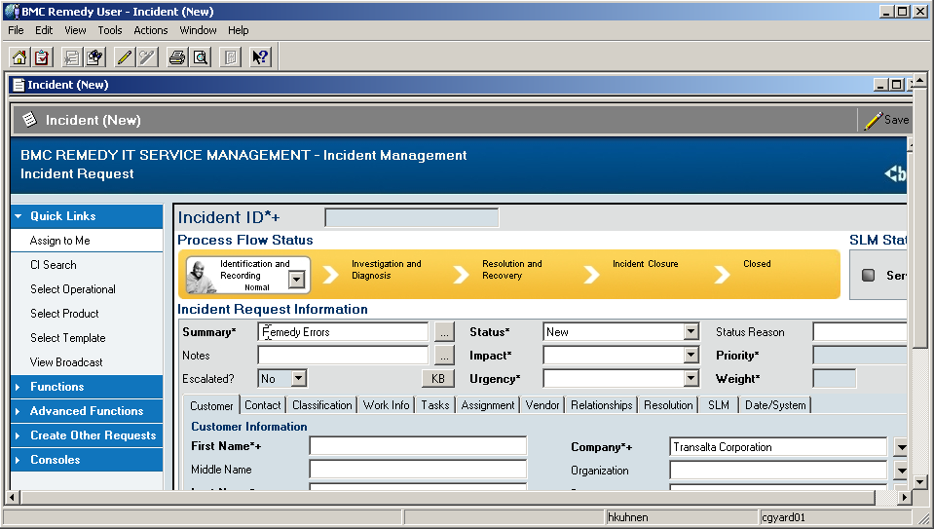
Remedy Integration
SDKB can be launched in context
(Summary field as input – KB Button)

Slide 23
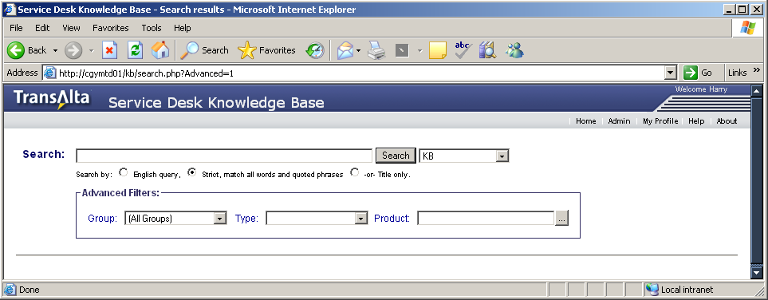
Advanced Search
Filters can be used to modify or refine the search.
To search by document ID, enter Document ID in the search field
e.g. KB0000011.

Slide 24
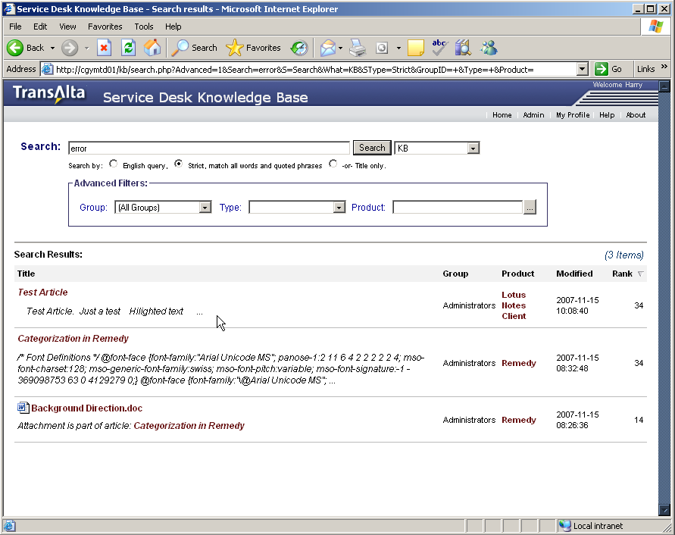
Results List
Select Title to view article
Article List can be sorted by selecting the column header

Slide 25
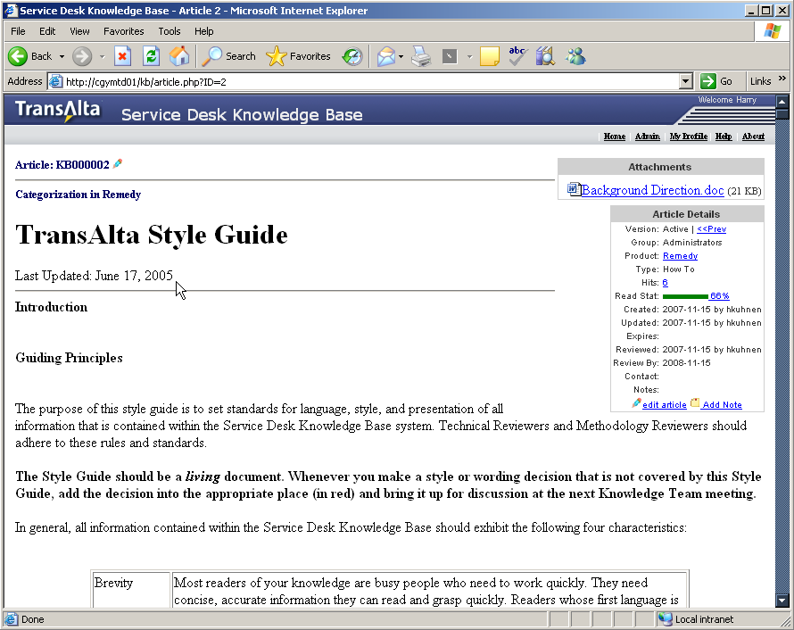
Viewing an Article
Article can be updated with: edit article option
Select product link to view other articles associated with a product
Generate feedback with: add note option
Other details displayed are the basic article statistics including how many times viewed (Hits), article owner (Group) and who authored and reviewed the article (displayed for Approvers Only).
2
4
1
3

Slide 26
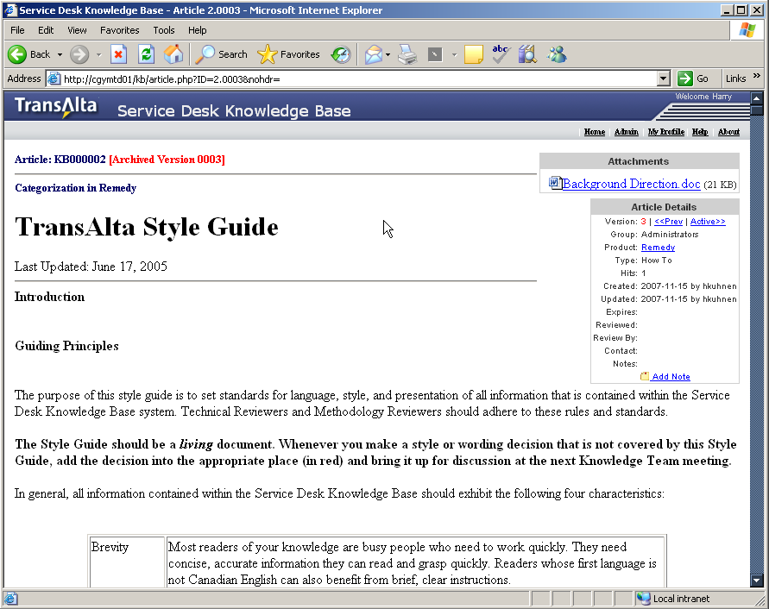
View Previous Version
  Approvers can view previous versions of the article when the
  <<Prev link is selected
The Article version is a red number listed after the article ID
Select Active>> to view the current version of the article

Slide 27
Reasons to link an article ?
A vital part of the KM process is: Articles that are used to assist a customer are linked to the case (incident)
Impact to business
  Improves content and ensures consistent solution delivery
  This practice allows for metrics to be gathered to measure the value of content
  Increases the accuracy and quality of the KB through participation and reuse by the whole IT workforce

Slide 28
How to link an article
From the results list, right-click on the article title
Select copy short-cut
Paste short cut in the Remedy solution field

Slide 29
Authoring

Slide 30
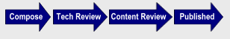
KM Process Workflow Steps
Compose - Default initial status indicates article in progress of being composed
Pending Technical Review - Indicates that the article requires a technical review. Only the article Author or Editors are able to view the article. The article needs to be reviewed by a subject matter expert for technical accuracy
Pending Content Review - Indicates that the article requires a content/methodology quality review before being published. Only the article author or Editors are able to view the article
Published When the approved article is available for distribution via the web
Active – Normal Article status. Any member of the current group may view the article
Obsolete - Article is no longer active. Only editors or the article author may view
When an article is Pending Technical or Content Review, an Editor must select “Mark Reviewed” to activate the article
Selecting “Mark Reviewed” when the status is Pending Content Review will record the article as reviewed and change the status to Active

Slide 31
Steps to Create a New Article
From the home page, Select
Enter the details for the article as prompted
Choose a template to match knowledge content type
Replace template text with article content & Select
Move completed article to the review step by Selecting

Slide 32
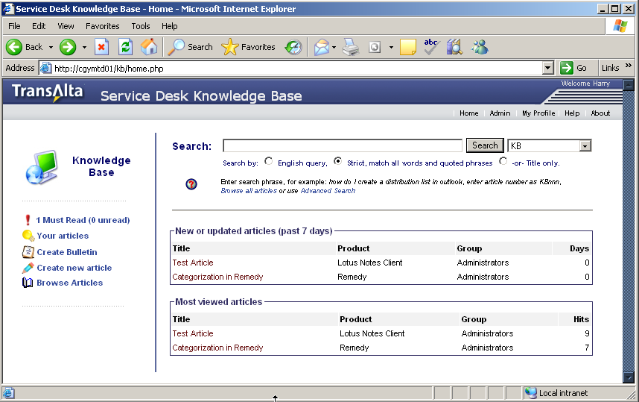
Create New Article
From the home page, click “create new article”
The details page is displayed

Slide 33
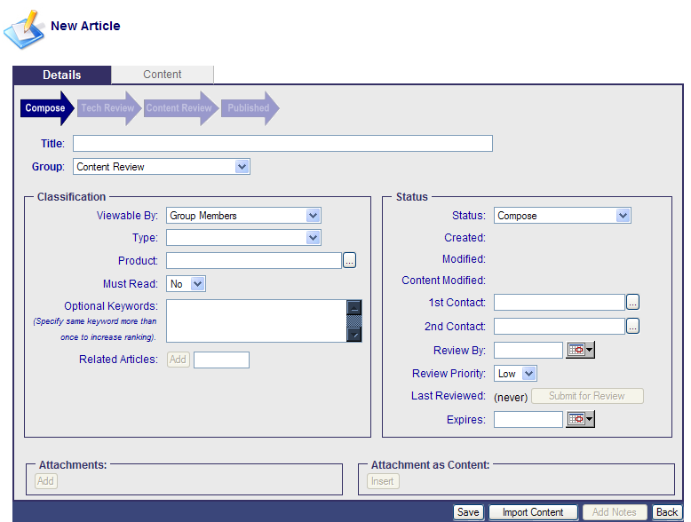
Require Details
Enter the details (metadata) for the article
  Title Enter a descriptive title of the article (ex. Dell CPU Removal)
  Group Select the appropriate authoring group
  Type Select appropriate type
  Product Enter a product name or select from the list.
1
2
3
4

Slide 34
Type Definitions
Procedure = Used for any process, not related to trouble shooting a problem.
Training / How To = Used to document QFG's FAQ's manuals and general how to do something.
Troubleshooting = Used for any error messages, symptoms to resolve technical issues.
Schedules = Stores shift schedules or other dynamically changing information kept by the help desk.

Slide 35
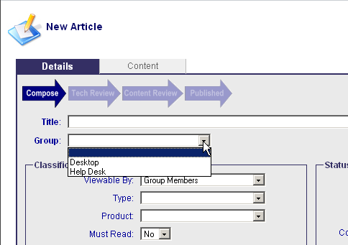
Authoring Groups
Content is organized based on the Remedy Support Groups. KM Authors are members of the groups based on the products they support. Articles are managed by the entire group not an individual contributor.
Users must complete the required training, before becoming an Author, and be assigned by the KM Administrator to the appropriate authoring group. Once a user becomes a member of an authoring group they are able to create and edit articles in the authoring groups they are a member of.
  When the user launches Knowledge Capture, the system recognizes the groups assigned to their profile and grants access. A user can be a member of more than one authoring group.
  The Group drop down list includes all authoring groups available to the user.

Slide 36
Optional Details
Enter the details (metadata) for the article and click “content tab”.
  Must Read Select “Yes” if you would like this article to appear on the “must read” section of the home page.
  Optional Keywords specify keywords to increase the ranking
  Review Priority
  Expires (enter a date if the article expires – an article that is only valid for a specific period of time; perhaps in support of a project)
  Viewable By should always be set to public unless it is group specific materials

Slide 37
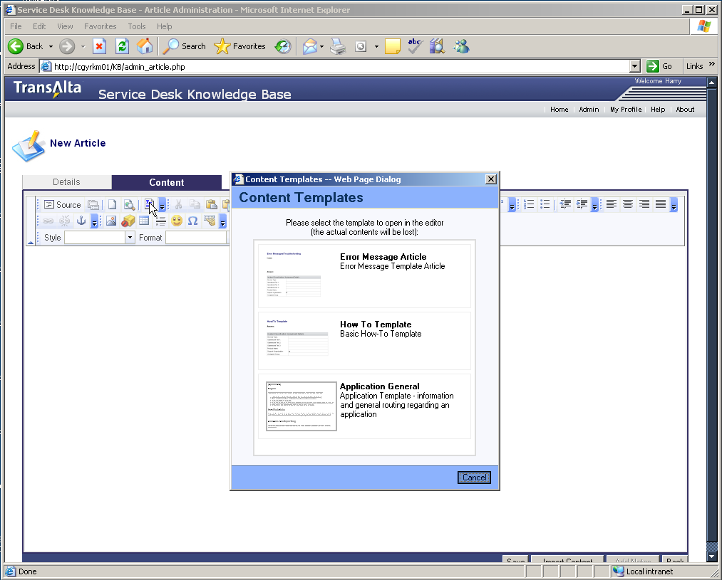
Select Template

Slide 38
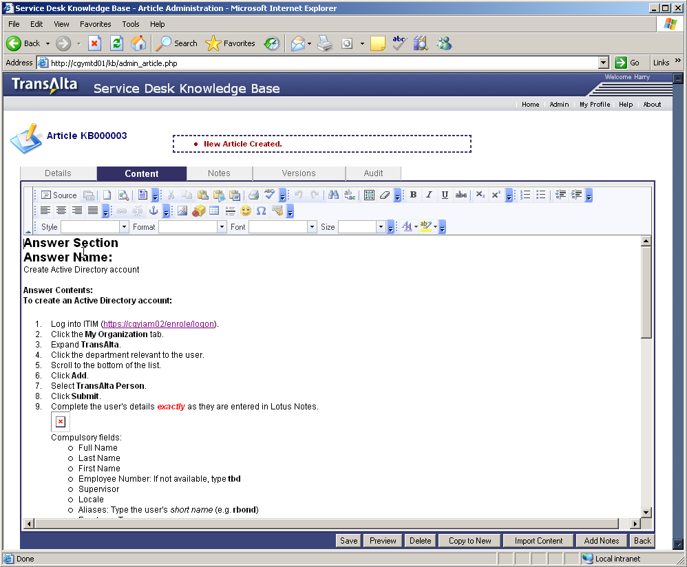
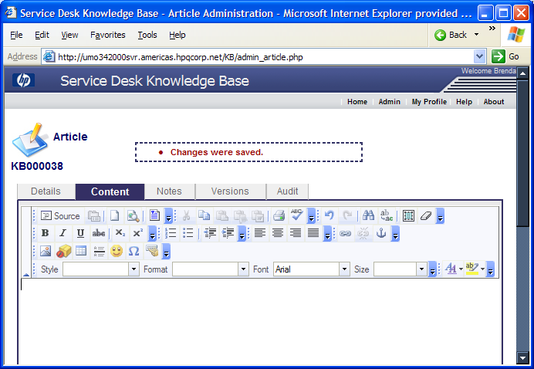
Enter Article Text
Replace template text with article content.
Click “Save” when finished
  Write about only one issue/solution per article.
  Enter details of problem or question as described by customer, as well as additional details.

Slide 39
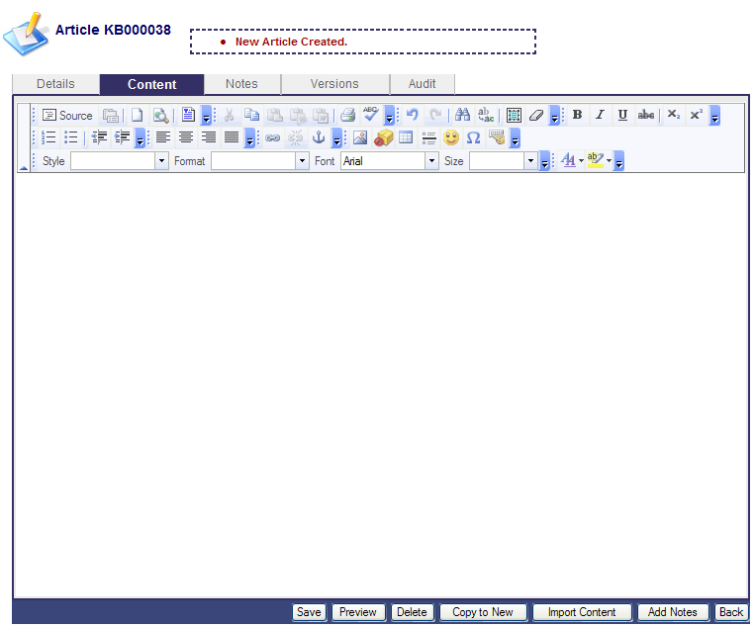
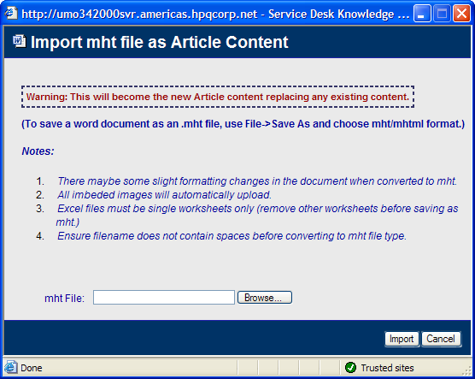
Import Content
The “import content” feature allows you to upload a .MHT file which will be converted to HTML and stored as the Article content.
  MHT files can be produced from Microsoft Word by saving a document in .MHT/MHTML format
  MHT files can contain images which are embedded in the file.
  Large MHT files should be attached, not loaded as content
  Some formatting problems can occur on complex documents.

Slide 40
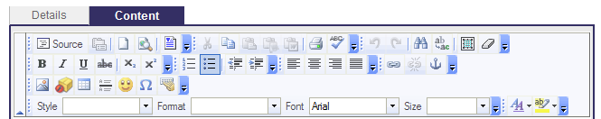
Authoring solution Bar
Knowledge Capture uses an HTML editor. HTML provides many advantages for repurposing with minimal or no formatting rework.
Most of the standard MS editing options are available within the Knowledge Capture editor.
  Hover your mouse over the button to reveal the function it performs.
Keep in mind that published articles will be conformed to style sheet used by the publisher, so don’t spend extra time formatting font size, color and style.

Slide 41
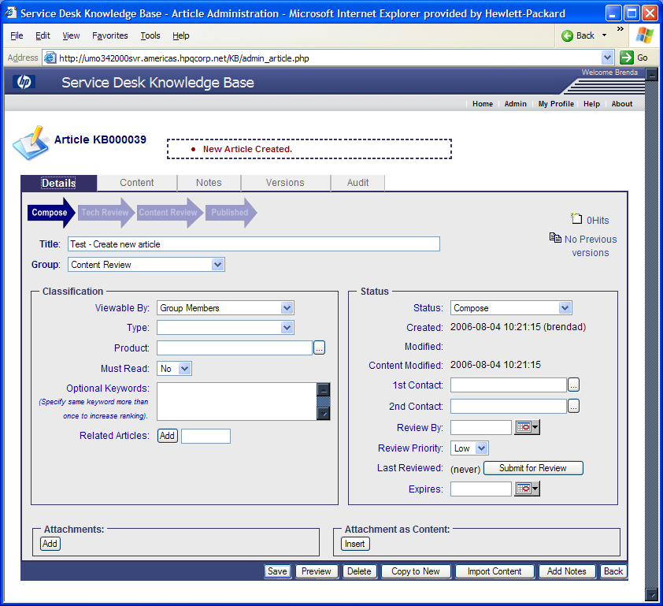
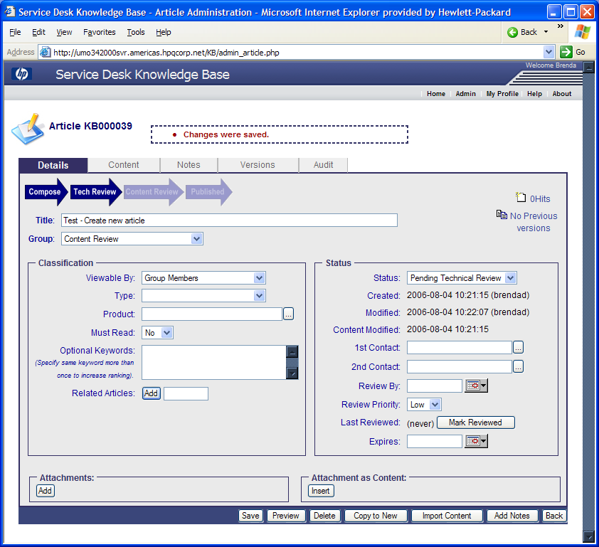
Submit For Review
The article is available in composed form. After completing the article, move it to the review step by clicking “submit for review”.

Slide 42
Updating
Articles

Slide 43
Updating Articles
Minor Changes – make in place, just edit the article
When you are making a Major change we request that you:
  “Copy to New”
  Update new article and move to Active through the process
  When an article is moved to active, change the status of the original article to “Obsolete” and put a link into the article pointing to the new article. This way links will not be broken, and through update requests we can be notified of link issues.

Slide 44
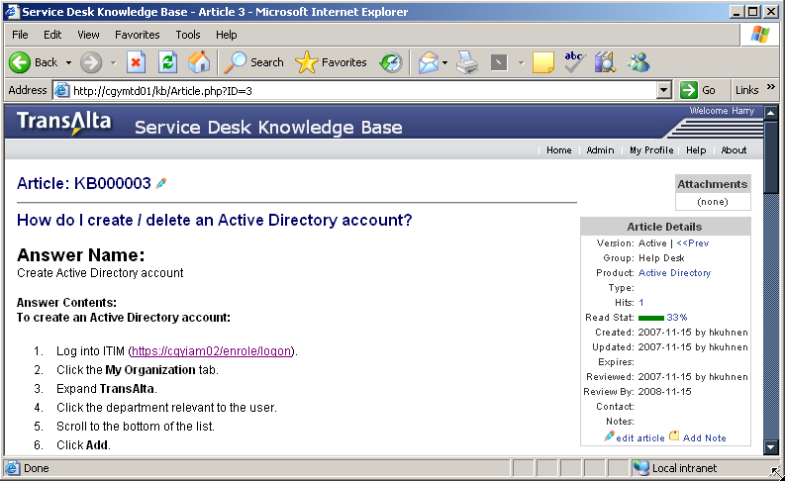
Updating Articles
  From the article view, click on the “edit article” icon to view the details page.
  Click on “content tab”, input changes and click “save”.
  If author privileges do not allow you to edit articles directly, provide your feedback via the “add note” option.

Slide 45
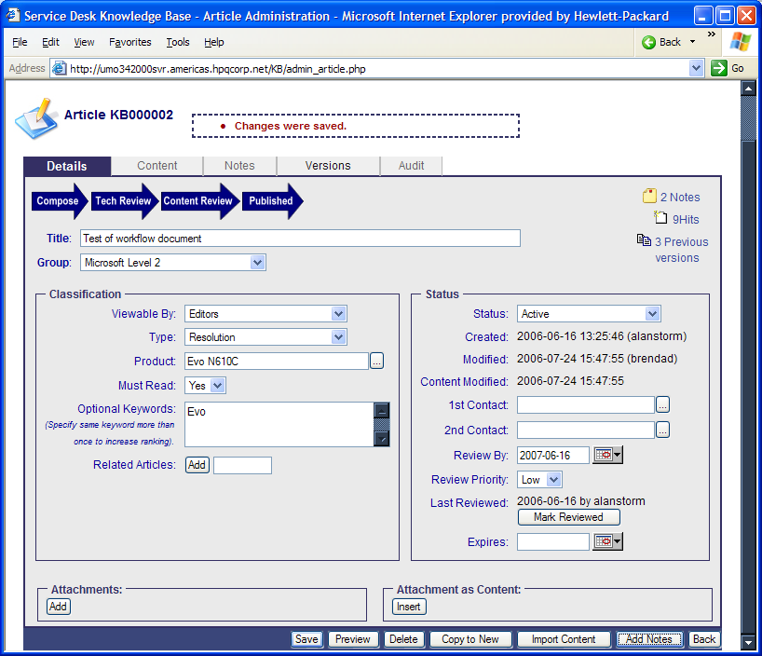
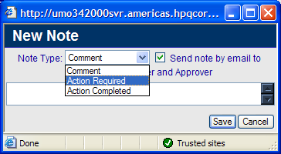
Updating Articles
  If the changes are technical or procedural, then the article needs to be technically reviewed.
  Click “add notes”, select “action required” add description of changes made.

Slide 46
Technical Review
Process

Slide 47

Expectation of Technical Reviewers
The Technical Reviewer ensures that content is technically valid and appropriate for the intended audience. Reviewers have a Capture profile entitling them to access articles in the pending technical review state. Reviewers inherit the rights of an Author and can create new articles or edit existing articles as needed.
In the KM environment, articles which are created, are immediately available by others searching the knowledge base. It is critical that all new articles are technically accurate.
As articles move through the workflow they will be prepared for public access. The articles must be contextual, relevant, and technically accurate
Responsibilities
  Check for articles marked as Pending Technical Review
  Review articles for technical accuracy and appropriateness for the intended audience
  Edit article as necessary or provide feedback to the Author for updating
  Mark article as Reviewed
  Collaborate with other Reviewers in their Support Group
Technical Reviewers are subject matter experts for the products they support and are assigned by the coordinator or manager
Each team may have one or more Technical Reviewers. The Technical Reviewer responsibilities are to be performed in an addition to the regular support role
A Technical Reviewer needs to take a few extra minutes each day to check for articles pending technical review

Slide 48
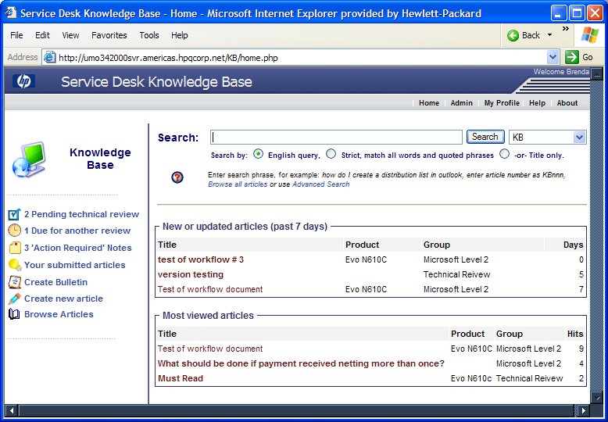
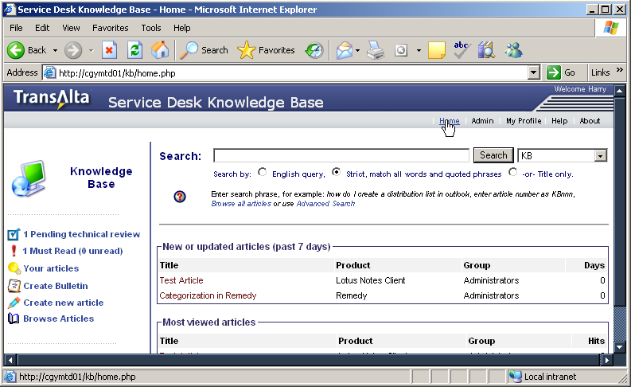
Technical Review Process
Reviewers will see an indicator on the home page when an article needs to be reviewed.
Click the “pending technical review” icon to view articles needing to be reviewed.

Slide 49
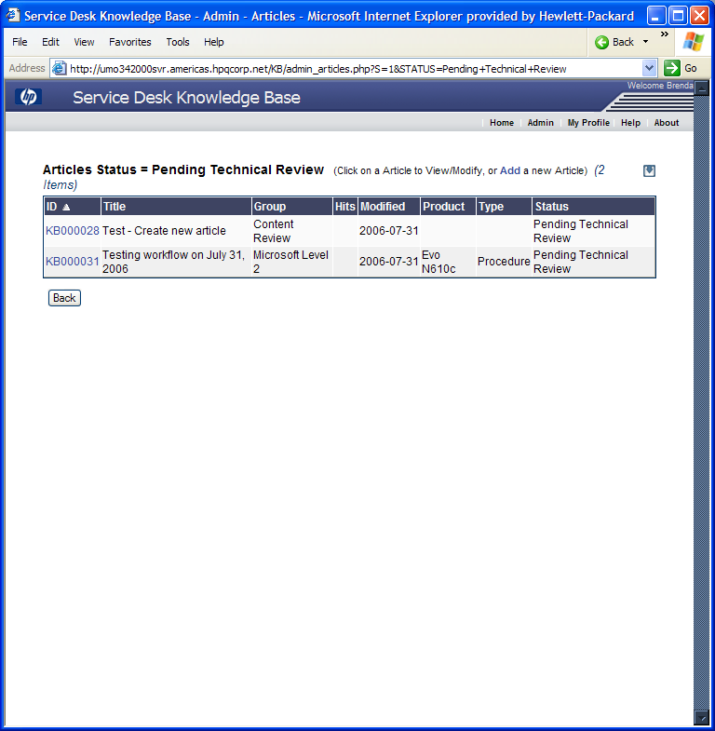
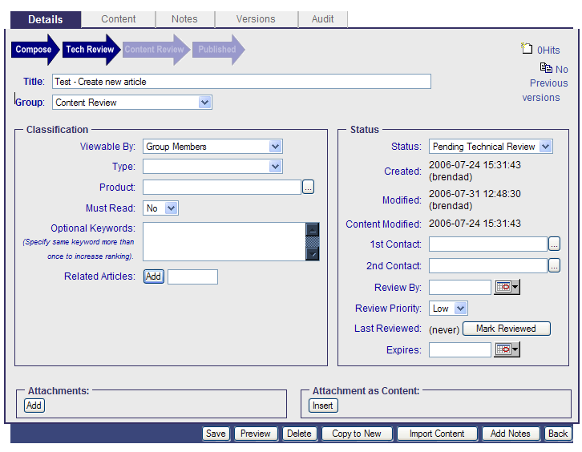
Technical Review Process
Click on the article ID to open the article in edit mode The details page will be presented
Click on the “content” tab to view the article
Using the review criteria, evaluate the article for technical accuracy from the content or details tab, click “save”, click “details” tab
Click “mark reviewed” on “details” tab
1
2
4
3

Slide 50
Technical Review Criteria
The article must meet review criteria in order to be approved:
Technically accurate and complete (no steps missing)
Well organized, information in logical sequence
Technical areas are described at the appropriate level for the intended audience
Text and illustrations are technically correct and apply to the text
Contains suitable notes, cautions, and warnings
Review the article from the perspective of the intended audience. Put yourself in the place of the reader and apply the article to the task for which it was written. Follow the procedures and instructions. Do they work? What would you change?
Before the article is published externally or translated, the Content Reviewer team will apply appropriate grammar, spelling and structure. Therefore, do not unnecessarily focus on these elements

Slide 51
Content Quality
Process

Slide 52
Expectations for Content Reviewer
The Content Reviewer ensures that articles meet quality standards. It is vital that Content Reviewer have product knowledge and that they are knowledgeable about writing standards and publishing guidelines.
Responsibilities
  Checks daily for articles in the Pending Content Review state.
  Determines if the article is editorially appropriate for publishing.
  Finalizes content according to writing style guidelines.

Slide 53
Content Quality Review Criteria
As part of an ongoing content quality review process, the content reviewer will review and approve documents authored within the workflow. The criteria listed below are used to evaluate the content quality and adherence to writing standards.
Criteria | Description
Document is not clear | Document is not complete, clear, and/or concise. It cannot standalone. Details of steps are missing or do not make sense for “customer self-solve”.
Incorrect language used | Used slang, jargon, contractions (can’t), excessive use of “you”, past or future tense, spelling errors.
Inappropriate for audience | Not written to the lowest level of technical understand or not written for external customer.
Statement is too specific | Used customer/agent name, computer name, or internal reference.
Incorrect or missing tables and lists | Incorrect use of numbered lists (used for sequential steps) or bulleted list (used for a list.
Title structure and content | Title should refer to the symptom, not the cause or resolution
Duplicate | Solution for the described issue already exists.
Products not assigned | Return for missing products.
Article details not assigned or incorrect | Details or metadata is not assigned correctly.
Customer speak | Article includes words the customer uses when describing the problem. It is important that the content review process does not strip out the language used by the customer to describe the problem. Using "customer speak" makes the article more searchable.

Slide 54
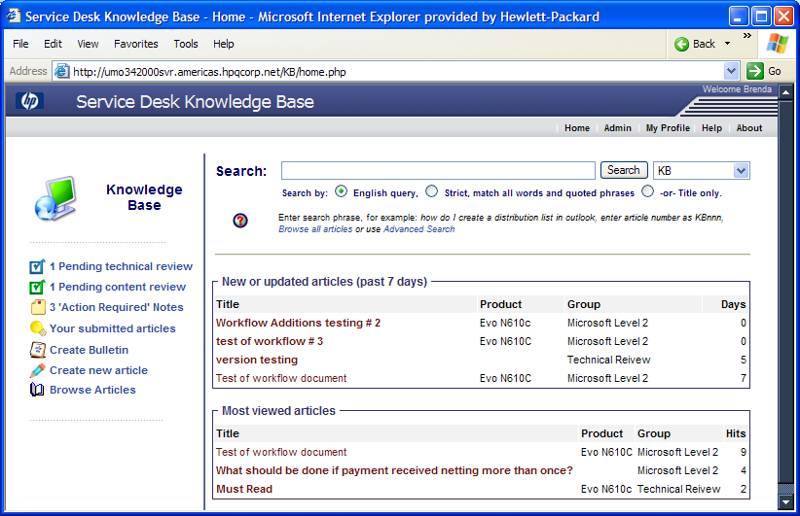
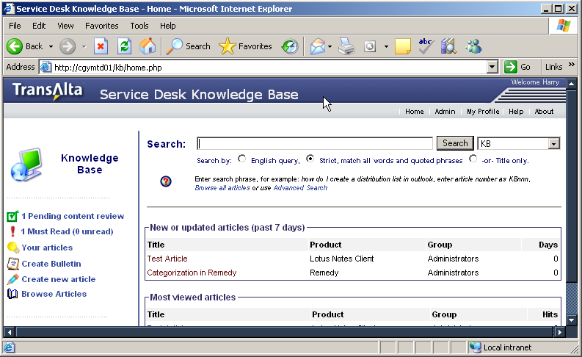
Content Review Process
Content reviewers will see an indicator on the home page when an article needs to be reviewed.
Click the “pending content review” icon to view articles needing to be reviewed.

Slide 55
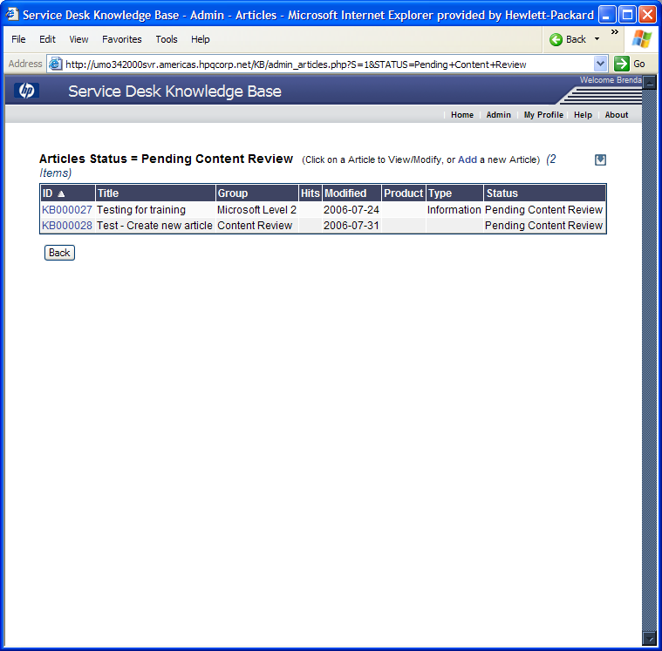
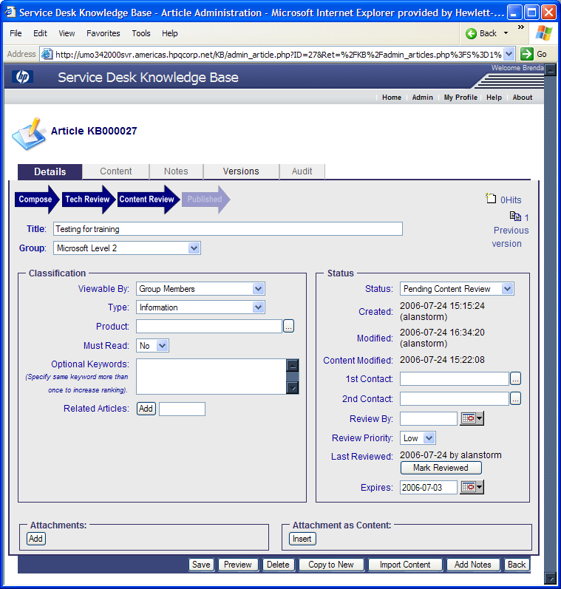
Content Review Process
Click on the article ID to open the article in edit mode, the details page will be presented
Click on the “content” tab to view the article
Using the quality criteria, evaluate the article, from the content or details tab, click “save”, click “details” tab
Click “mark reviewed” on “details” tab
1
2
4
3

Slide 56
Providing Feedback on an Article
Feedback to Author
  The Technical Reviewer should provide feedback to the Author with if:
  Article is so poorly written that it is not understandable
  Changes required are extensive
  Making the feedback and suggested changes will increase the learning of the Author
Feedback to Technical Reviewer
  The Content Reviewer should provide feedback to the Technical Reviewer if:
  Writing guidelines are habitually not followed
  Article is duplicate
It is good to provide feedback if it will be a learning experience for the Author or Reviewer and if feedback is actionable and effectively communicated.
Feedback should be provided within 24 hours of when the review is performed.

Slide 57
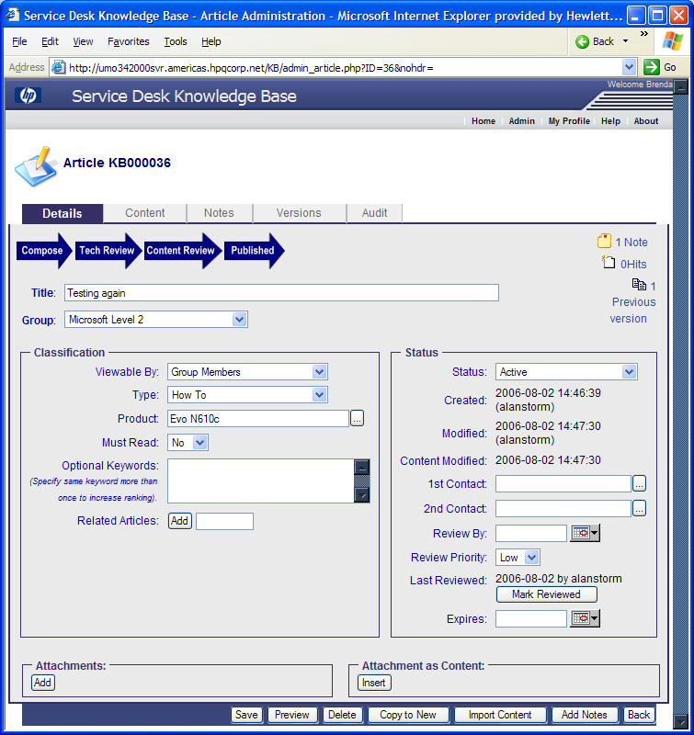
Deleting Articles
Go to the details page and click “delete”
As you are working in SDKB you may create an article that you realize is a duplicate or is not needed. In case this you should delete the article if you are sure that no other articles are linked. If you are unsure then obsolete content rather than delete
  Only members of the authoring group have permission to delete an article
  When the original author is not known, anyone in the authoring group can delete the article
  The most common reason for deleting an article is because there is a duplicate article or the article appears to be an abandoned draft article
  Articles which have been deleted have actually been permanently removed from the knowledge base

Slide 58
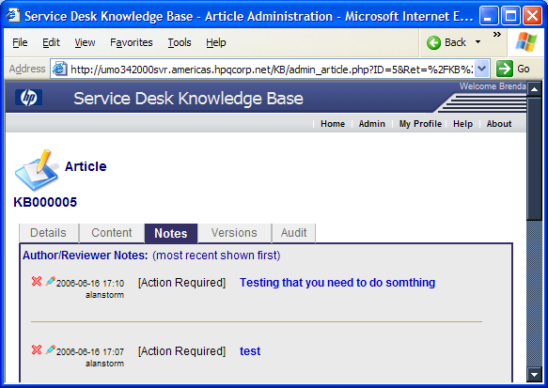
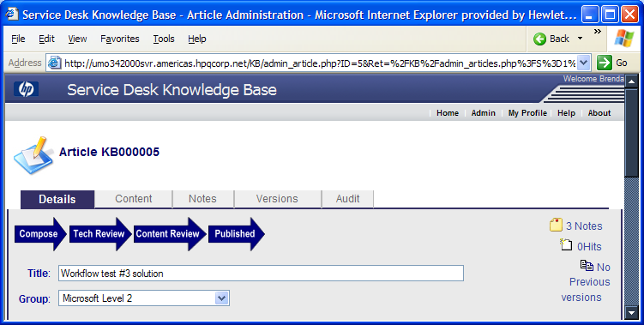
Viewing Notes
Go to the details page and click “notes”
The notes page displays the notes entered
Click on the to delete the note after action has been taken

Slide 59
Best Practices

Slide 60
Before Creating a New Article…
Authors should thoroughly search the knowledge base for a solution to their customer question before creating a new article
Each solution used to help a customer should be reviewed for any opportunity to enhance or update the content
If a solution is not found the Support Specialist must use the established escalation or troubleshooting path to come up with a resolution for the customer. Once the solution has been discovered,
the Author uses the Knowledge Management solution to create a new article
If a portion of the solution is known, capture the content in the “composed state” and collaborate with others to complete the article before moving it to be technically reviewed

Slide 61
When to Create New Content
If there is no solution addressing your issue.
  New questions/issues
  Undocumented questions/issues
  Process knowledge
When you want to share knowledge
  Useful undocumented knowledge, does not have to be generated from customer case (i.e. working in the lab, FAQs, tips and, etc.)
Common sources for new articles:
  Emerging issue or newly discovered solution resulting from a customer interaction
  Information shared verbally among support professionals
  Legacy content collection may contain source materials to be used in generating a new article
  Unstructured case text may be refined into a useful, single topic article.
  Relevant and useful segments of PDF files or manuals (PDF files cannot be linked to cases)
  When you want to share useful undocumented knowledge (results from working in the lab, FAQs, troubleshooting guides, tips etc.

Slide 62
Uploading MS Word Files
When using MS Word for articles you must first save the document with proper zoom setting
When using MS Word, save the document while the zoom is set to 100% before inserting the document into the article
Why?
  Once the article is created, it keeps the saved zoom setting and will use that setting when opened by any reader. You can imagine a document saved while at 300% zoom, resulting in an article with bloated text – the reader will need to reduce magnification by double clicking within the document and reduce magnification

Slide 63
Author Content Quality Checklist
To ensure that you have written a high value article ask yourself the following:
  Are all the details present
  Are the steps presented in the correct order
  Is the solution presented tested
  Are there sentences that could be shorter
  Is the terminology clear and appropriate for the intended audience
  Is the title based on the issue or problem and does it contain the affected products
  If attachments are used, does the graphic meet the format and size guidelines
  Are the words of the customer incorporated into the text i.e. "Customer Speak"
  Are there any spelling errors (run spell-check)

Slide 64
Writing Standards

Slide 65

Writing Standards
Having a consistent use of styles and structure across support contents has the following benefits:
Improved usability of articles
Increased opportunity for content reuse
Decreased translation and localization costs
Greater capacity to manage a high volume of content
Easier forecasting and/or change because of current processes and content usability
While it is not the intent to require the support workforce to adhere to a strict set of writing standards, using these guidelines will improve the content at the source and reduce the impact or change to the content downstream as it is prepared for publishing to external web sites.

Slide 66
Writing Standards
Writing standards must be consistently applied to articles created using the Knowledge Capture solution. The following styles standards are most common and will be part of a quality check
  Template
  Article titles
  Lists
  Tables
  Links
  Attachments
For a more extensive set of writing guidelines refer to KM Methodology and Style Guide
http://itsm/KB/article.php?nohdr=1&ID=468

Slide 67
Templates
There are different structured templates used to capture different articles types. Select a template which best fits the content you are authoring:
  Each articles should contain information about a single issue or topic
  Use the Issue/Solution type for FAQ articles
  Authors have the option to add other section headings as needed
  Use the procedural template for procedural type information

Slide 68
Article Titles
Correctly formatted articles titles impact the usability and searchability of content. Follow these guidelines with all articles created using Knowledge Capture.
How To:
The title should reflect the question that a user might typically ask
How do I request a Lotus Notes account?
Troubleshooting/Error Messages
The title should contain the error message or describe the problem as a user might see it.
Err: Could not connect to Lotus Notes
Guidelines:
Be specific and concisely summarize the contents of the articles.
If the articles content is about troubleshooting/error messages, base the title on the issue not the solution.
The title enables fast and accurate search if it is based on the problem
or the issue the articles addresses.

Slide 69
Lists
Lists are an effective way of presetting information. Lists help to organize the information for easier understanding
Guidelines:
  The SDKB editor automatically formats bulleted and numbered list items
  Numbered list items need to be formatted manually
  Use a numbered lists for sequential items
  Used a bulleted list for items or points not in a specified order
  Do not place punctuation after a list item. Exception: When the item is a complete sentence. If one item in a list must end with a period, end all items in the list with a period
How to:
  Position the cursor in the field where you want to enter the list
  Click on the solution bar to select either numbered or bulleted formatting
  Enter the items for your list

Slide 70
Tables
Guidelines:
Use tables to present information that is too complex for a list
Remember to use column heading to identify the type of information you are presenting
To avoid adding unnecessary formatting characters, do not use the Tab key while inside the table field
Do not nest tables, or put one table inside of another table. This will require rework in order to be published correctly
How to:
Position the cursor in the field where you want to enter the table
Click on the insert/edit table icon to create a new table and set table properties
An Insert Table dialog box appears. Set the number of rows and columns you want or accept the defaults. Click OK
The table is inserted. Enter the title and other information
Once the table has been entered into the articles, you can modify the table or the table contents as needed

Slide 71
Links
In general try to avoid the use of links in the KB solution.
However when required please strictly comply with the guidelines as published in the Style and Methodology guide.
Often time’s links become broken and cause customer satisfaction and quality problems.
Obsolete articles as identified as such rather than deleted

Slide 72
Attachments as Content
MS-Word, MS-Excel, PDF file, etc. can be attached and used as the article content without conversion
In this case the content body of the article is empty, and this attachment is viewed automatically embedded in the frame using its native application (MS-Word, MS-Excel, PDF Reader)
When you upload an Attachment as content, the Article Editor will disappear and this attachment will override the content
To update this content, you will need to press the Replace button and upload a newer version of the document. The previous version will be archived
SDKB does full text search of attached documents.

Slide 73
Import Content
MHT file may be imported as content and then updated within the SDKB solution
Many file types may also be attached to an article. These articles will be launched within the context of the native application
SDKB does full text search of attached documents
A search will return both a direct link to the attachment as well as a link to the article which contains the attachment
More than one attachment can be added to an article.
Graphics will be inserted at the cursor.

Slide 74
Best Practices
Keep in mind the following best practices to ensure that your article will add value:
  Make sure there is a need for a new article by checking for similar articles first
  Select the appropriate template
  Assign the article to the correct authoring group
  Write about only one issue/solution per article
  Create a good article title
  Use “customer speak" when writing; this means using language that the customers use when they call to report a problem. This will make the article more searchable
  Move articles through the workflow in a timely manner
  Identify content to be removed from the knowledge base

Slide 75
Knowledge Management -
SDKB Alignment

Slide 76
KM Process

Slide 77
Knowledge Management – SDKB Alignment
The selected Knowledge Management solution suite does not fully align with and automate the process
Manual intervention is required at some points to align

Slide 78
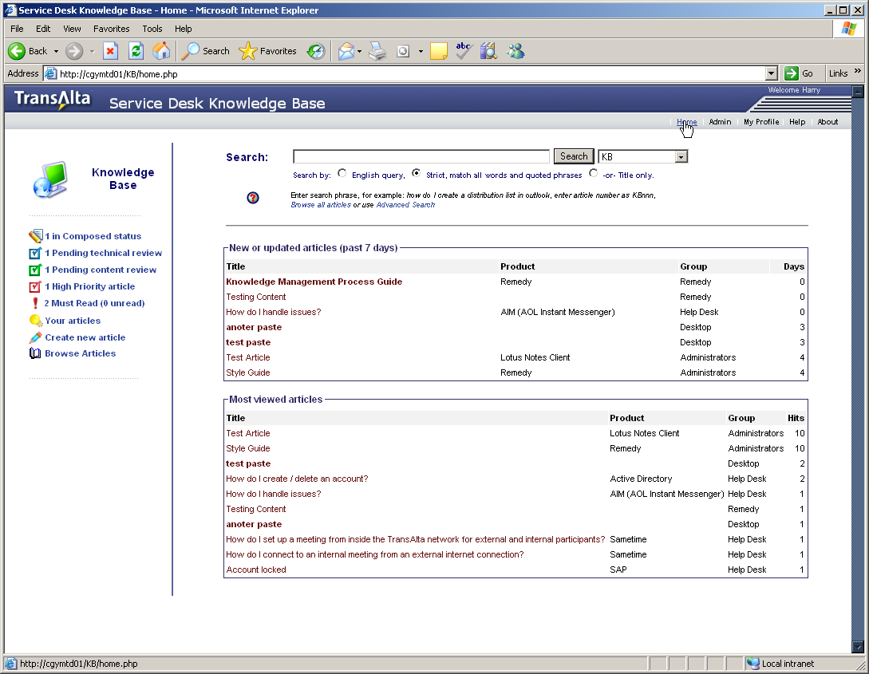
Creating content
Anyone with permissions can create content

Slide 79
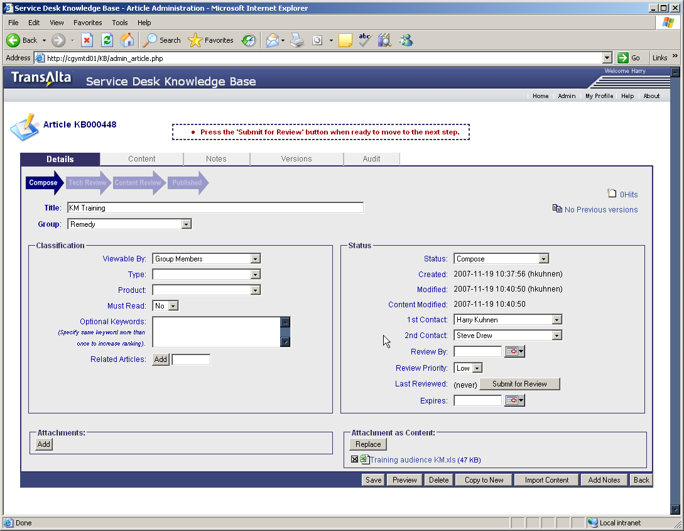
Submit for Technical Review
When content is ready, submit for Review
Once submitted for review only personnel assigned with Approval permission can update

Slide 80
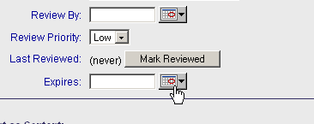
Technical Review
Content Owners/Support Groups review content to ensure that it is technically and operationally correct
These are group members with “Approval” permissions
When complete “Mark Reviewed”

Slide 81
Content Review
At this point the Knowledge Management Administrator will review the article to ensure it is properly categorized and to ensure that content aligns with the TransAlta style and methodology standards
The KM administrator will typically publish the article
You should review the article when you are notified it has been published

Slide 82
Knowledge Management -
Article Review

Slide 83
Our Request
We will provide you with a list of articles for which we believe you have ownership
Please review and update to ensure content is current and technically accurate
Ensure that categorization and assignment instructions align with the Remedy solution
Replace any OVSD references with appropriate Remedy instructions

Slide 84
Guidelines
Use appropriate template
Document assignments in the included tables
  Make copies if necessary
In some cases a single request may require the involvement of many support teams – for example when a new user is “on-boarded“
Instruction should be to create a “Master” incident record and then child records for each of the various teams that must be involved

Slide 85
Other
At this moment all of you have administrator access to the solution, so that you can change ownership and products as necessary
Please be careful to not inadvertently alter other group’s documents
If addition KM solution specific workgroups need to be created, let us know
If products are missing or a more generic product ID is required …

